Slide 1

3D Modeling Tool
Algorithmic Design Tool
3D Modeling Tool

Slide 2
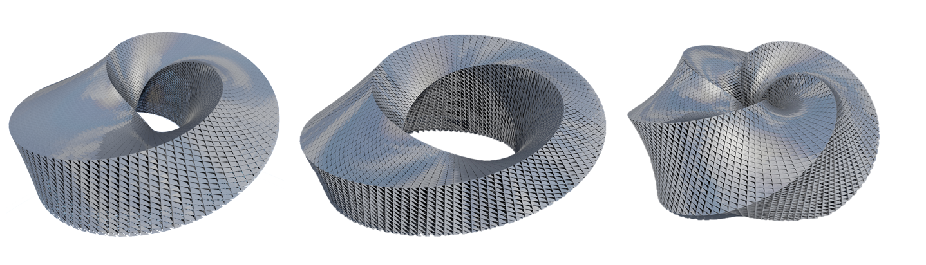

Slide 4
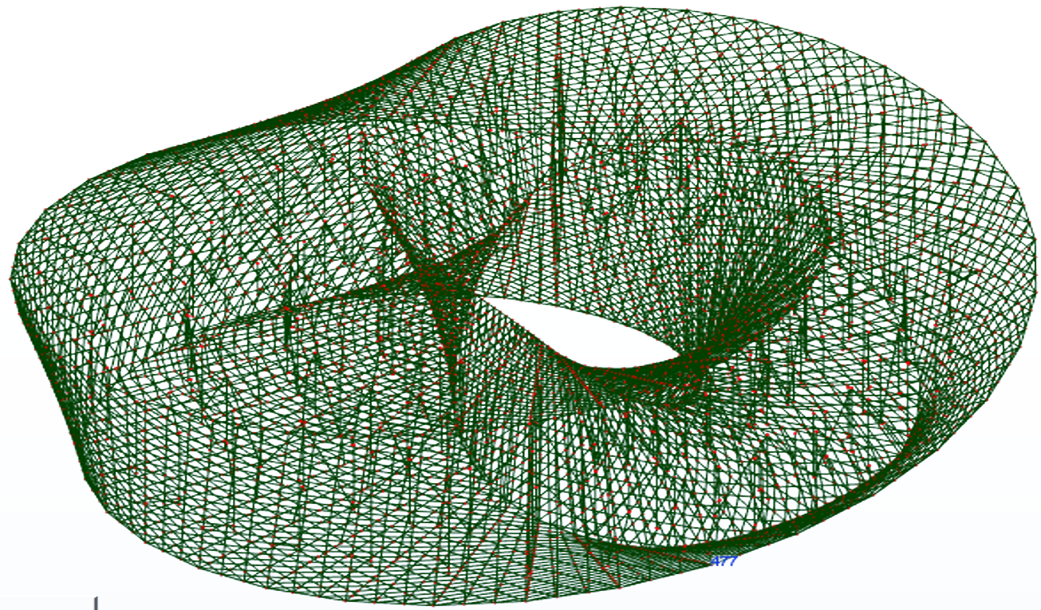
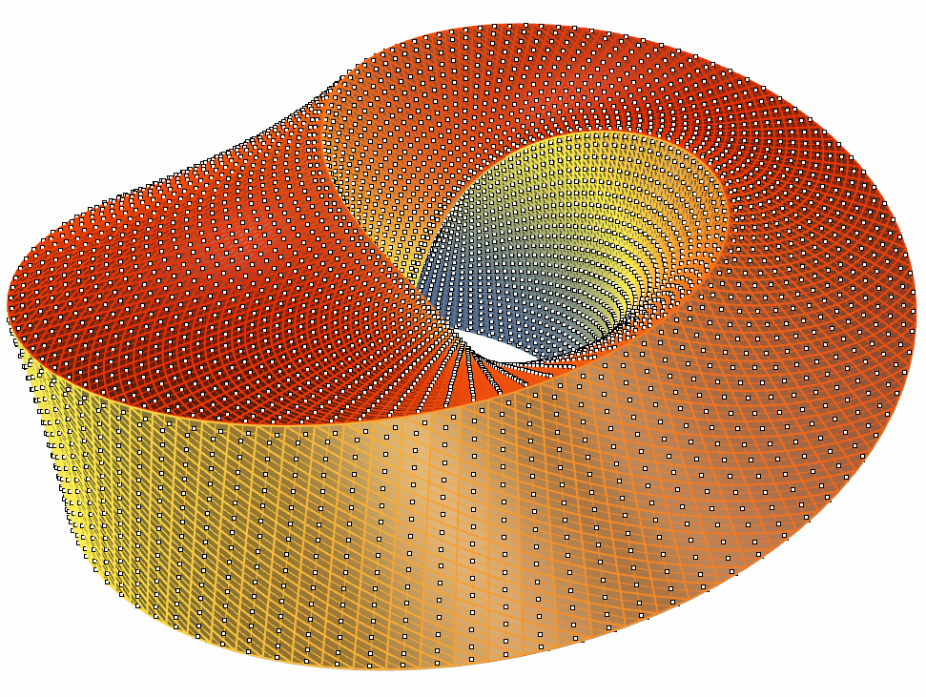

Slide 5
3D Modeling Tool
Algorithmic Design Tool
Analytical Tool 1
...
Analytical Tool n

Slide 6
3D Modeling Tool
Algorithmic Design Tool
Analytical Tool 1
...
Optimizer
Analytical Tool n

Slide 7


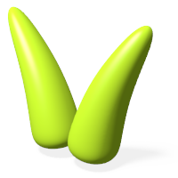


Grasshopper
Dynamo
Galapagos
Goat
Silvereye
Octopus
Opossum
Optimo

Slide 8
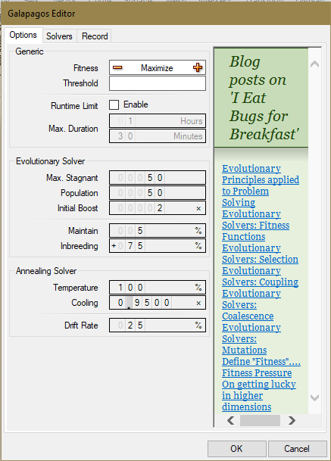
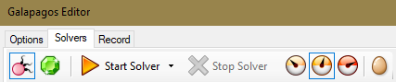
Galapagos
Fitness goal
Fitness goal threshold
Time Limit Options
Genetic Algorithm Solver
Simulated Annealing Solver
Solutions’ display options
Information about Galapagos
Genetic Algorithm
Parameters
Theoretical posts about evolutionary solvers
Simulated Annealing
Parameters

Slide 9
Galapagos
Fitnessgoal threshold
Time Limit Options
Genetic Algorithm Solver
Simulated Annealing Solver
Solutions’ display options
Information about Galapagos
Genetic Algorithm
Parameters
Theoretical posts about evolutionary solvers
Simulated Annealing
Parameters

Slide 10
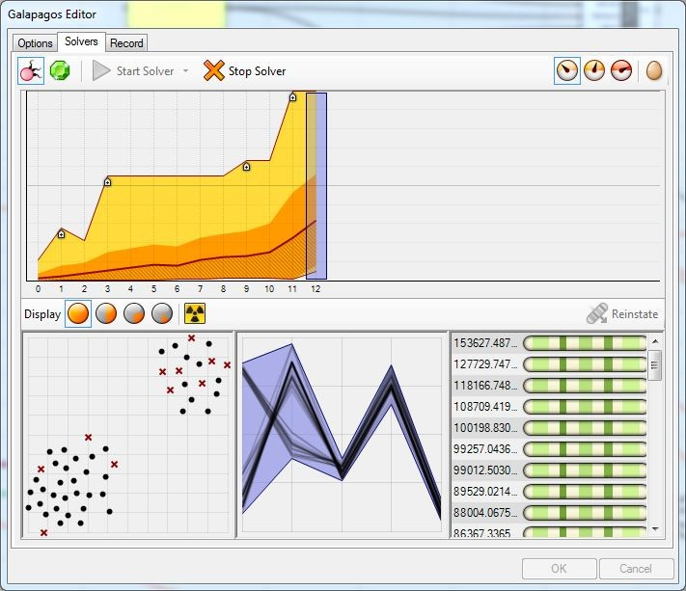
Galapagos
Genetic Algorithm Solver
Simulated Annealing Solver
Solutions’ display options
Version Information
Fitness goal
Fitness goal threshold
Time Limit Options
Better fitness value found
Population’s average fitness value
Genetic Algorithm
Parameters
Best Fitness found ever
Simulated Annealing
Parameters
Theoretical posts about evolutionary solvers

Slide 11
Galapagos Setup View
Objective Function Goal
Fitness goal threshold
Time Limit Options
Genetic Algorithm
Parameters
Simulated Annealing
Parameters
Theoretical posts about evolutionary solvers

Slide 12
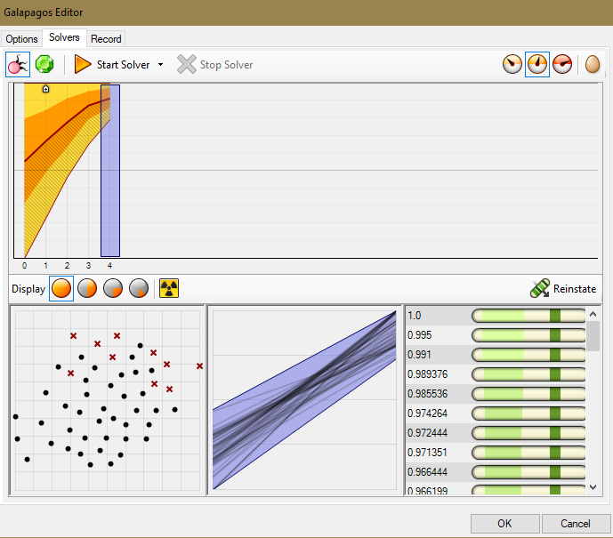
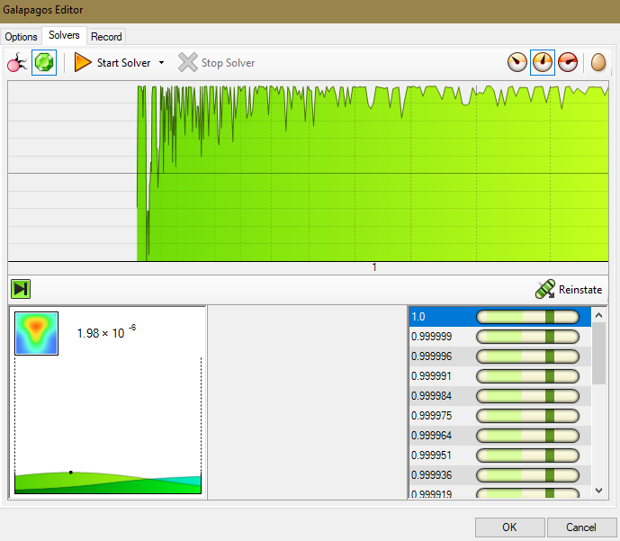
Galapagos – Results view

Slide 13
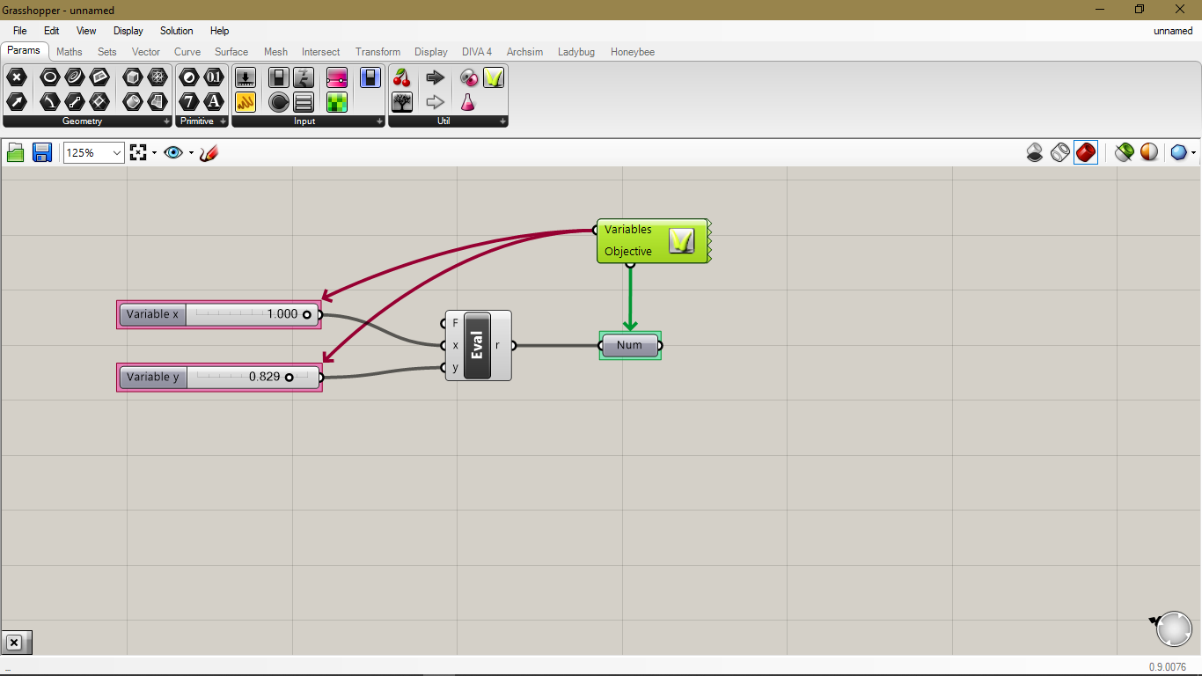
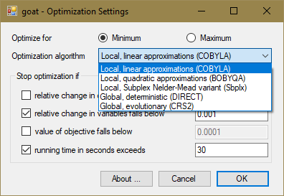
Goat

Slide 14
Octopus

Slide 15
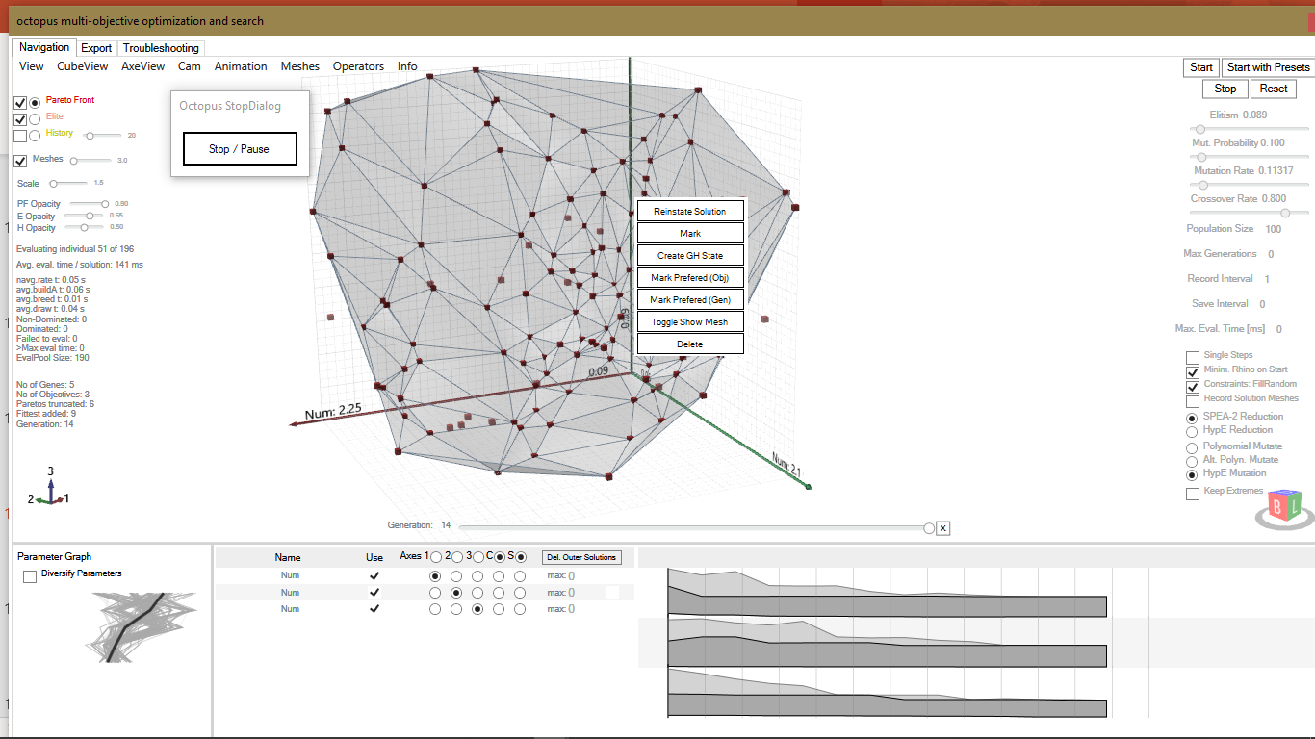
4
6
1
5
2
7
3
8
9
10

Slide 16
Optimo

Slide 17
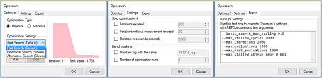
Opossum

Slide 18
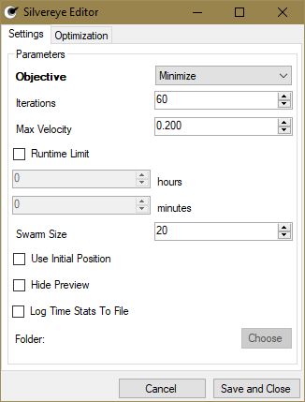
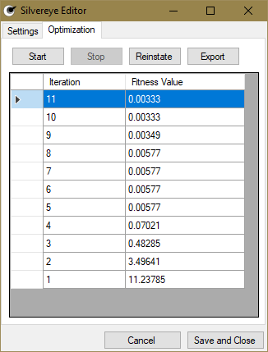
Silvereye

Slide 20
Solution

